Slide 1
Mancala.java
By: Charlie Comeau and Nikhil Havanur

Slide 2
Rules
The twelve sections in the middle each contain four marbles.
A player can only select marbles from their row (like arrays-row dominated)
Marbles are placed individually in each of the succeeding holes until they are exhausted.
Marbles are moved counter-clockwise. Marbles are deposited in player’s own bank, and skip over the opponent’s bank.
If the final marble lands in a player’s pile, the player gets another turn.
If the final marble lands in an empty hole, then the player receives that marble and the marbles directly across.
Once one row is completely exhausted, the other player will get the remaining marbles in their row, and the game is over.
Player with most marbles at end WINS

Slide 3
Idea process
One person game app
Vs. “artificial intelligence” (Math.random())
Use Scanner class to take in user input
Played in interactions panel of Java
2 separate java files: class file and runner program
Methods must be in compliance with rules
Brute force testing

Slide 4
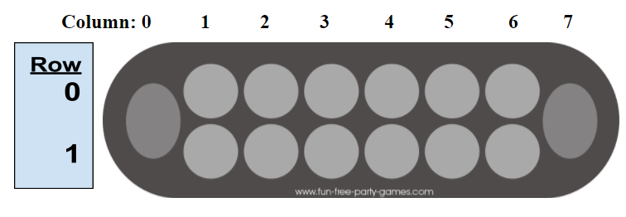
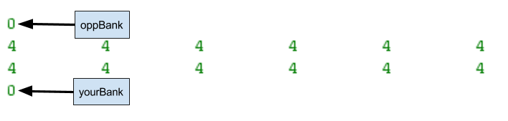
Format
2-D array
Actual bank is in yourBank and oppBank variables
Row 0, computer’s row
Row 1, user’s row

Slide 5
Class File Components
private int[][] game = new int [2][8];
This 2D array is the Mancala board (2 rows and 8 columns).
private int yourBank = 0;
Represents the status of the player’s bank.
private int oppBank = 0;
Represents the status of the computer’s bank.
private boolean goAgain = false;
Represents if final pebble lands in the player’s bank.

Slide 6
Methods
Mancala Constructor
Populates 2-D array with pebbles
yourMove(int row, int col)
Executes user move based off of parameters
oppMove():
Executes computer move based off of Math.random()
getYourBank()
Accessor method for yourBank variable

Slide 7
Methods Continued
getOppBank()
Accessor method for oppBank variable
getGoAgain()
Accessor method for goAgain variable
checkEnd()
Checks if all of one row is empty to see if game has ended
finalCollect():
Goes after checkEnd(), sweeps the board for any remaining pebbles
.

Slide 8
Methods continued
findWinner():
After finalCollect(), determines winner
toString():
Prints out current status of Mancala board

Slide 9
Conclusion / Lessons Learned
Design phase is crucial-organization
Implementation is secondary
Diligent troubleshooting with real life Mancala board

Slide 10
1 v. 1 us Mr. Hatcher!!!

